Slide 1
The Church of Jesus Christ Fort Worth Restoration Branch Praise Him 2 Worship HIM
10:00 AM June 9, 2019

Slide 2
Program
Prelude Robin
Welcome Tommy
Scripture Reading Psalm 69:29 - 35
Opening Hymn Never Be Discouraged (Robin playing with Congregation Singing) #388
Invocation Jeff
Reading Praise #1 - Bill
Remarks Kathey
Song Onward to Zion (Robin playing with Congregation singing) #447
Remarks Larry
Song What a Friend We Have in Jesus (FWRB Band with Congregation Singing) #317
Reading Praise #2 - Bill
Remarks Story of Sweet Hour of Prayer - Jessie
Song Sweet Hour of Prayer (FWRB Band with Congregation Singing) #309
Remarks Bonnie
Song If You Say Go (FWRB Band)
Poem Poem of Praise – Tammy
Remarks David
Song Praise God (FWRB Band – Any Kids in attendance can help with this one)
Benediction Steve
Response Praise Him, Praise Him (Bonnie Playing with the Congregation Singing)

Slide 3
Call to Worship
Psalms 69:29 - 36
But I am poor and sorrowful; let thy salvation, O God, set me up on high. I will praise the name of God with a song, and will magnify him with thanksgiving. This also shall please the Lord better than an ox or bullock that hath horns and hooves. The humble shall see this, and be glad; and your heart shall live that seek God. For the Lord heareth the poor, and despiseth not his prisoners. Let the heaven and earth praise him, the seas, and everything that moveth therein. For God will save Zion, and will build the cities of Judah; that they may dwell there, and have it in possession. The seed also of his servants shall inherit it; and they that love his name shall dwell therein.

Slide 4
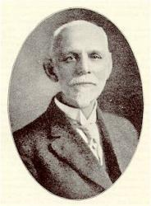
Never Be Discouraged
(Robin playing with Congregation Singing)
# 388
There are moments in my life when we just want to throw in the towel and give up. On what? anything that’s overwhelming at that moment.
We’ve all felt pretty drained and alone one time or another. And it makes us feel spent. In times like these, especially in times like these, I encourage you to turn to your Bible for guidance.
Psalm 34:17-19 When the righteous cry for help, the Lord hears and delivers them out of all their troubles. The Lord is near to the brokenhearted and saves the crushed in spirit. Many are the afflictions of the righteous, but the Lord delivers him out of them all.
Psalm 147:3 He heals the brokenhearted and binds up their wounds.
Psalm 55:22 Cast your burden on the Lord, and he will sustain you; he will never permit the righteous to be moved.
Isaiah 41:10 Fear not, for I am with you; be not dismayed, for I am your God; I will strengthen you, I will help you, I will uphold you with my righteous right hand.
J. H. Fillmore
June 1, 1849 - Feb­ru­a­ry 8, 1936

Slide 5
Reading – Praise #1 - Bill
When we are willing to give to God the sacrifice of praise, knowing that He is good and merciful even in the midst of our trials or suffering, we give Him an opportunity to minister peace and comfort to our hurting hearts. No matter what is happening in our lives, our God is worthy of praise.

Slide 6
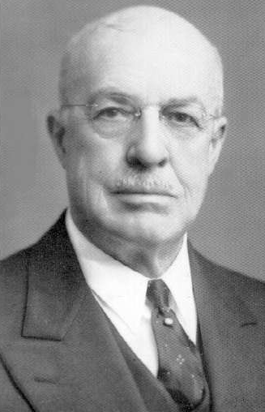
Onward to Zion
(Robin playing with Congregation singing)
# 447
Favorite Hymn of Kathey Howard
Frederick Madison Smith, generally known among his followers as "Fred M.", was the third Prophet-President of the Reorganized Church of Jesus Christ of Latter Day Saints, serving from 1915 until his death.
Smith's paternal grandfather was Joseph Smith, Jr., the founder of the Latter Day Saint movement, and his father was Joseph Smith III, the first president after the Church's "Reorganization."
The first graduate of Graceland University, Fred M. earned a Ph.D. in psychology from Clark University in 1916, setting him apart as one of the most highly educated members of his church at the time.[1]
F.M. Smith
January 21, 1874 - March 20, 1946

Slide 7
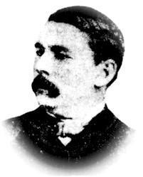
What a Friend We Have in Jesus
(FWRB Band with Congregation Singing)
# 317
Favorite Hymn of Larry Openshaw
Scriven was born in Dublin in 1820, was a graduate of Trinity College, Dublin, and went to Canada when he was 25, and died there at Port Hope, on Lake Ontario, in 1886.
What a Friend we have in Jesus was, according to Mr. Sankey, discovered to be his in the following manner: "A neighbor, sitting up with him in his illness, happened upon a manuscript of 'What a Friend we have in Jesus.'
Reading it with great delight, and questioning Mr. Scriven about it, he said he had composed it for his mother, to comfort her in a time of special sorrow, not intending any one else should see it.“
Joseph Medlicott Scriven
September 10, 1819 - August 10, 1886

Slide 8
Reading – Praise #2 - Bill
All of us have to be intentional about praise. We have to choose to become people who make a commitment to express praise to God and to others about God. We have to choose to be both vulnerable and strong in expressing praise to God within the congregation. We lay aside any concerns about what other people are thinking or doing, and we simply focus on praising God with all of our hearts.

Slide 9
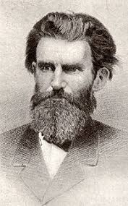
Sweet Hour of Prayer
(FWRB Band with Congregation Singing)
# 309
Favorite Hymn of Carol Peaton
William Walford was blind, but this did not make him worthless. On the contrary, as he sat by the fire in his English home in the mid-nineteenth century, his hands kept busy, whittling out useful objects, such as shoehorns. His mind was active, too.
Called on to preach from time to time in a rural English church,
Willam Walford composed sermons in his head to deliver on Sundays. He memorized a huge amount of the Bible which he quoted verbatim in his sermons. Some of his folk thought he had memorized the entire Scripture, cover to cover. William also composed lines of verse.
Willam Walford
1772-1850

Slide 10
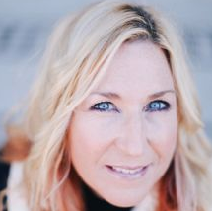
If You Say Go
(FWRB Band)
Favorite Hymn of Bonnie Erter
Marguerita Estell "Rita" Springer is an American Christian musician, who primarily plays a style of contemporary worship music and Christian pop music. Springer was born,
Rita Springer was born in Riverside County, California
She is a single mother raising her adoptive child in Hurst, Texas.
If You say "go" we will go
If You say "wait" we will wait
If You say "step out on the water"
And they say it can't be done
We'll fix our eyes on You and we will come
Your ways are higher than our ways
And the plans that You have laid
Are good and true
If You call us to the fire
You will not withdraw Your hand
We'll gaze into the flames and look for You
Rita Springer
April 17, 1967

Slide 11
If You Say Go
(FWRB Band)
If You Say Go
(FWRB Band)
If You say "go" we will go
If You say "wait" we will wait
If You say "step out on the water"
And they say it can't be done
We'll fix our eyes on You and we will come
Your ways are higher than our ways
And the plans that You have laid
Are good and true
If You call us to the fire
You will not withdraw Your hand
We'll gaze into the flames and look for You

Slide 12
Poem of Praise by Roger Horsch
Read by Tammy Norcross
I praise you Lord for the things you do
For you're with me every day
I praise you for the love you give
As you show me how to pray.
I praise you for the gift you gave
Through your suffering and sacrifice
I praise you for all the things you did
For the Love you give is nice.
I praise you for the blood you shed
As you cleansed me of my sin
You changed my life from what it was
You redeemed me from within.
I love you Lord with all my soul
Let me be faithful in all my ways
So I can enter your gates with thanksgiving
And, your courts with all my praise.

Slide 13
Praise God
(FWRB Band)
Original Song From the FWRB Youth
Praise God Creator of all things
Praise Him He is King of kings
Praise God for our friends and family
Praise Him for the land and the sea
Praise God Creator of the world
Praise Him for every boy and every girl
We praise God Almighty
For the love he has for us
The lame can walk the blind can see
In Him we put our trust
Praise God
Praise God
Praise God for the sustenance he gives
Praise Him in him we forever live
Praise God for forgiveness of our sins
Praise Him for His love that never ends

Slide 14
Benediction Steve
Response Praise Him, Praise Him #11 (Bonnie Playing with the Congregation Singing)

